Slide 1

HEALTHCARE DASHBOARD
GROUP 4
TEAM MEMBERS:-
Manasi More
RadhaRaman Jha
Priyanka Rajesh
Nasaraiah
Vidya Pise
Mentor
Mahendra Singh

Slide 2
KPI's
Patient Days
Net Patient Revenue
Discharges
Bad Debts and Charity Care
Financial Margins

Slide 3
INTRODUCTION
Healthcare dashboards serve as invaluable tools in this regard, providing real-time visibility into critical metrics.
Patient days and discharges offer insights into hospital utilization and bed management efficiency, while metrics such as bad debts and charity care reflect the organization's commitment to community health and financial responsibility.
Net patient revenue serves as a fundamental measure of the organization's financial health, encompassing revenue streams and reimbursement trends.
Financial margins offer a clear indication of profitability and operational efficiency. Healthcare dashboards empower administrators, clinicians, and financial analysts to make data-driven decisions.
Optimizing resource allocation, identifying revenue cycle inefficiencies, or ensuring compliance with financial targets, these dashboards facilitate proactive management and drive performance improvement initiatives, ultimately enhancing both patient outcomes and organizational sustainability.

Slide 4
Objectives of Healthcare Dashboard
Monitor Key Performance Indicators (KPIs)
Identify Trends and Patterns
Enhance Clinical Decision-Making
Optimize Resource Allocation
Improve Patient Experience
Support Population Health Management

Slide 5


Key findings and trends in healthcare data
Rising Costs
Shift to Outpatient Care
Increasing healthcare expenses impacting accessibility and affordability.
Requirement to Transition from inpatient to outpatient services for cost-effective care.
Technology Integration
Necessary to Embrace digital solutions for
efficient healthcare delivery and management.

Slide 6
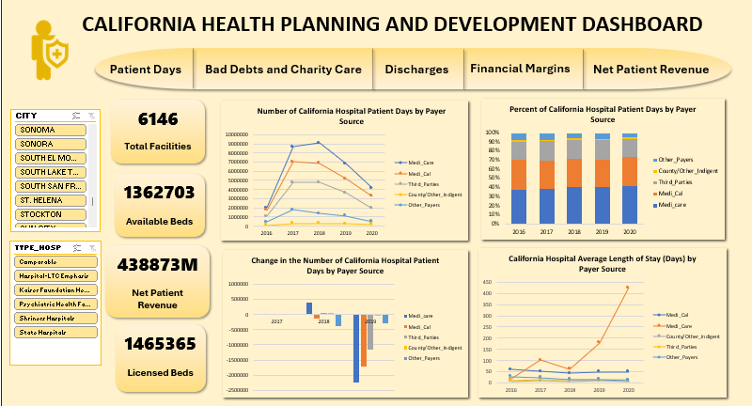
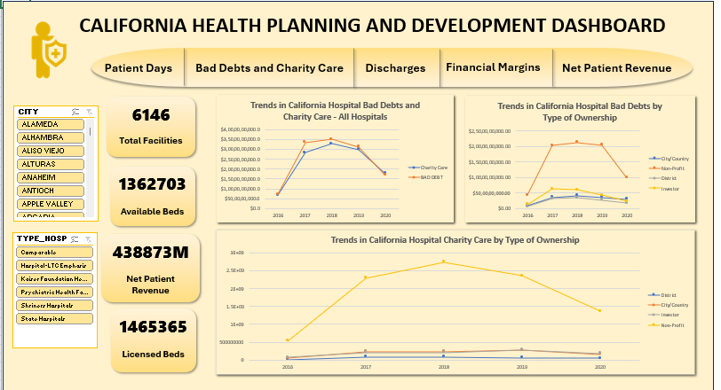
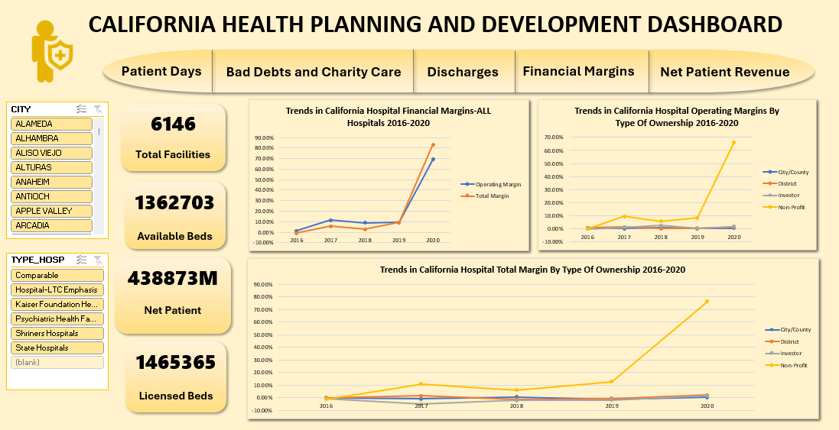
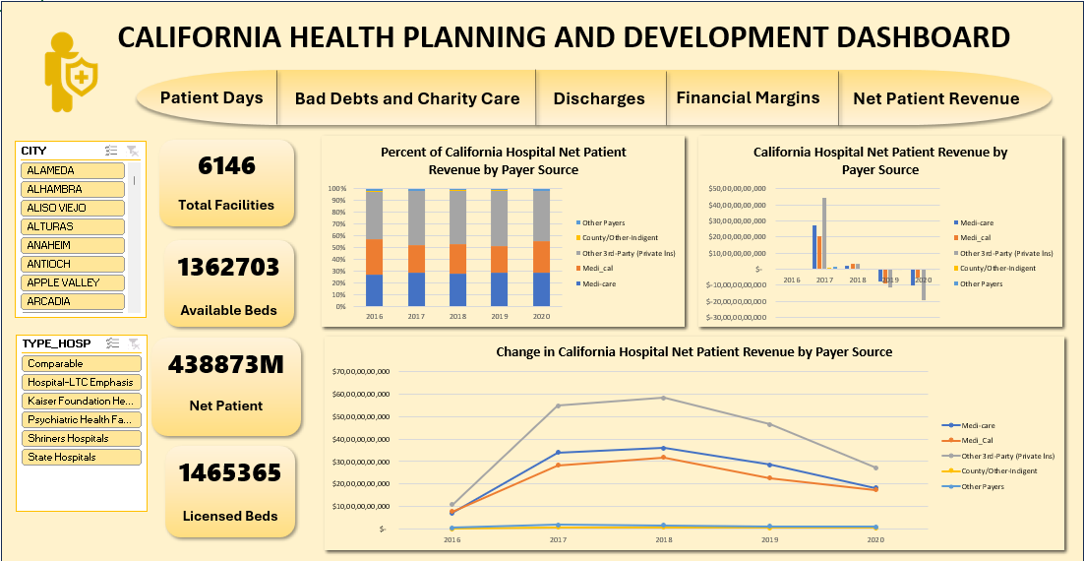
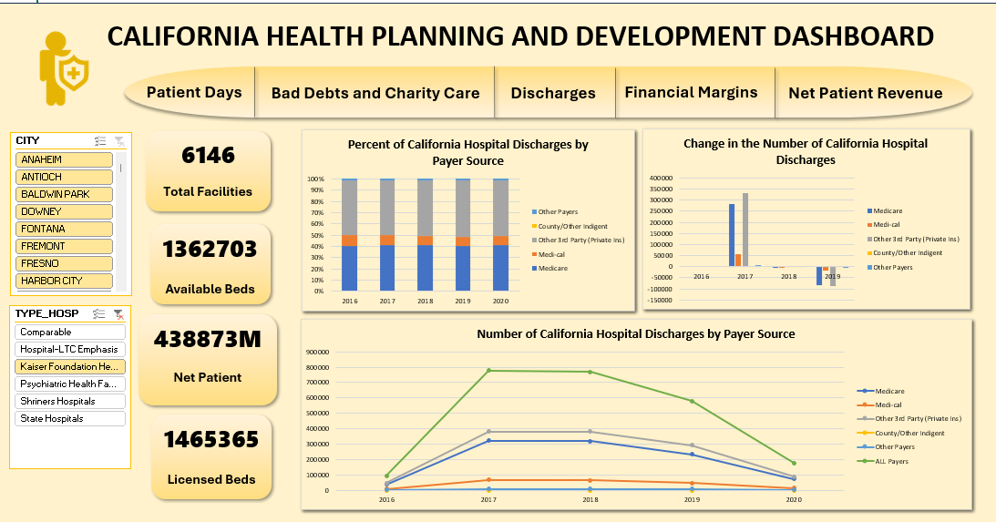
Excel Dashboard
Patient Days
Bad Debts and Charity
Financial Margins
Net Patient Revenue
Discharges

Slide 7
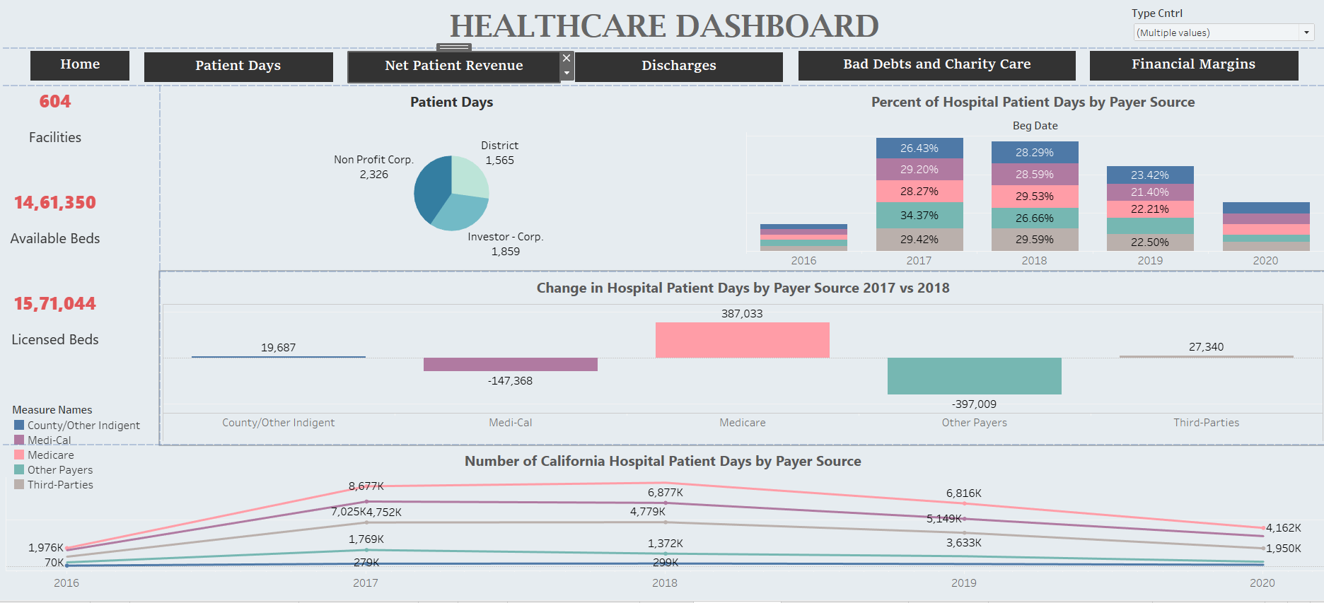
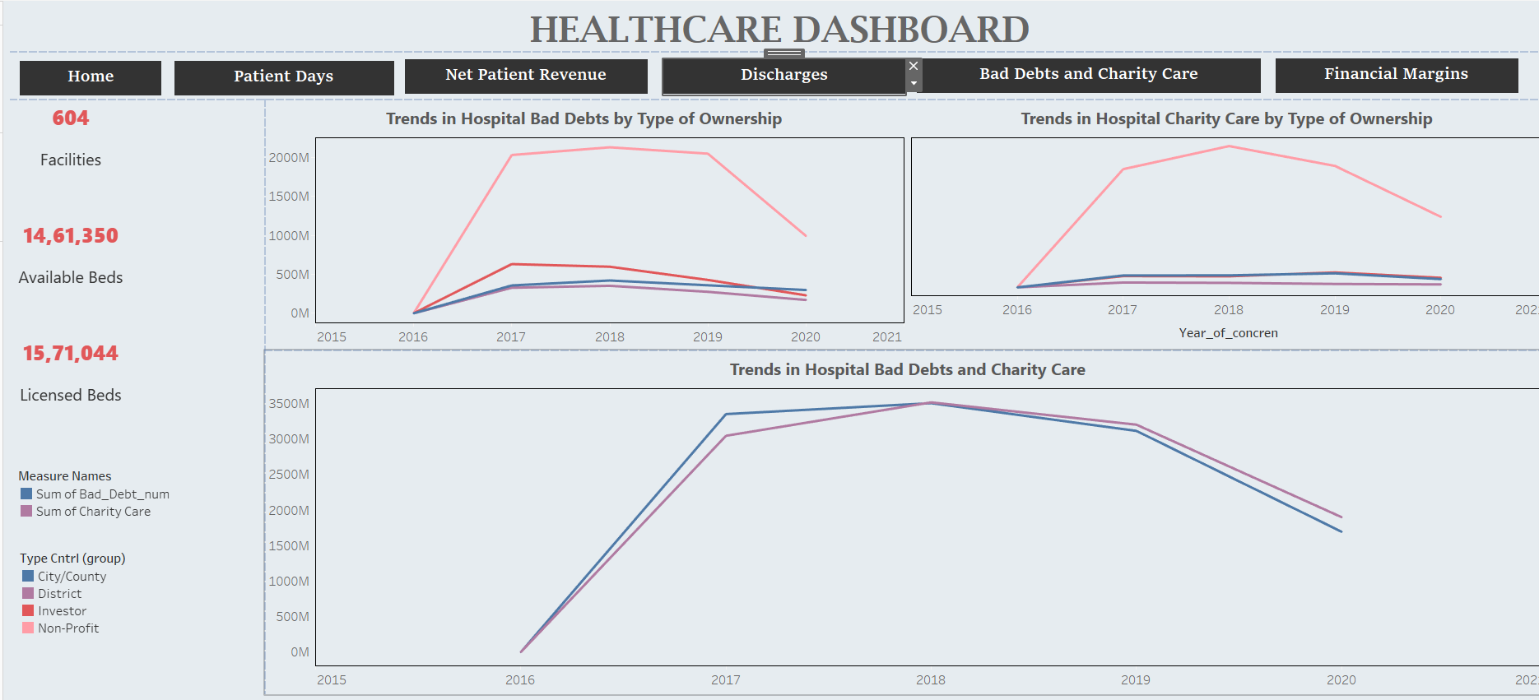
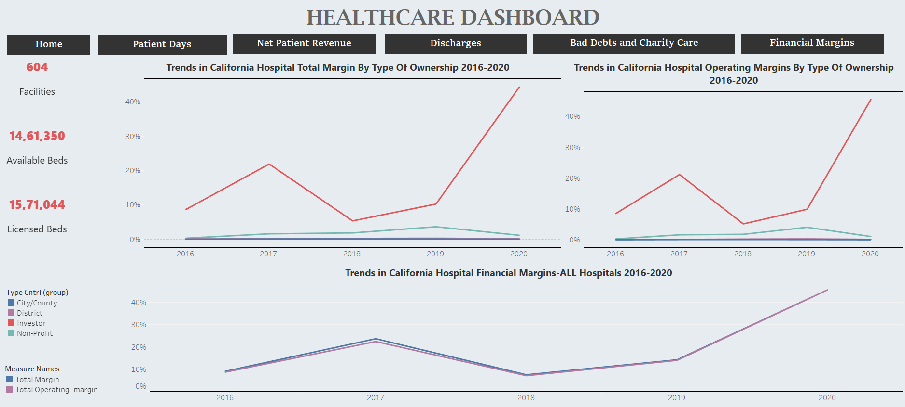
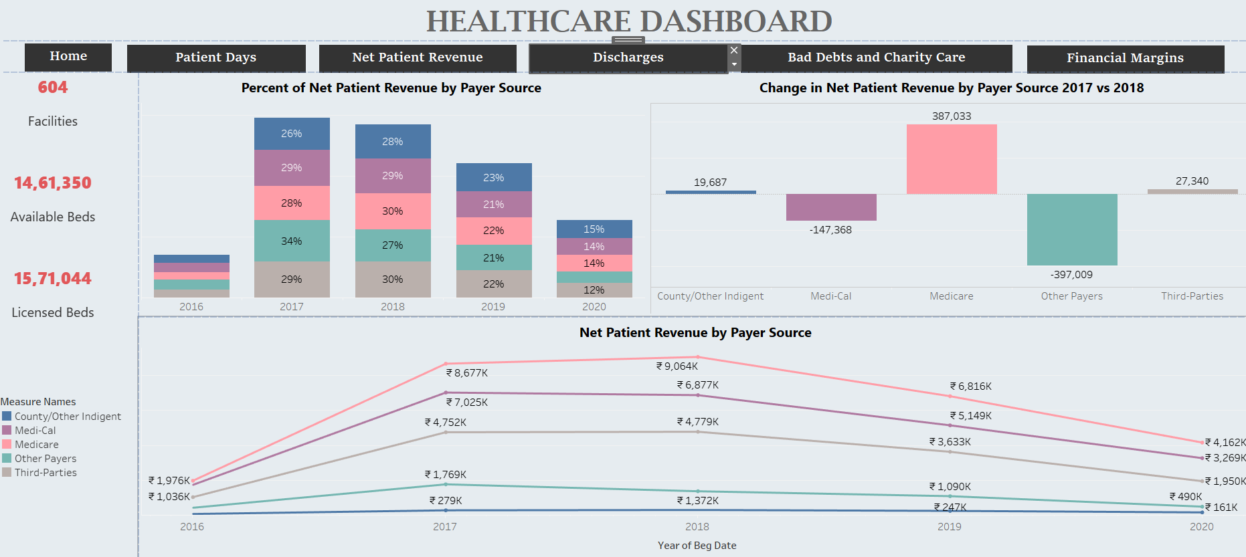
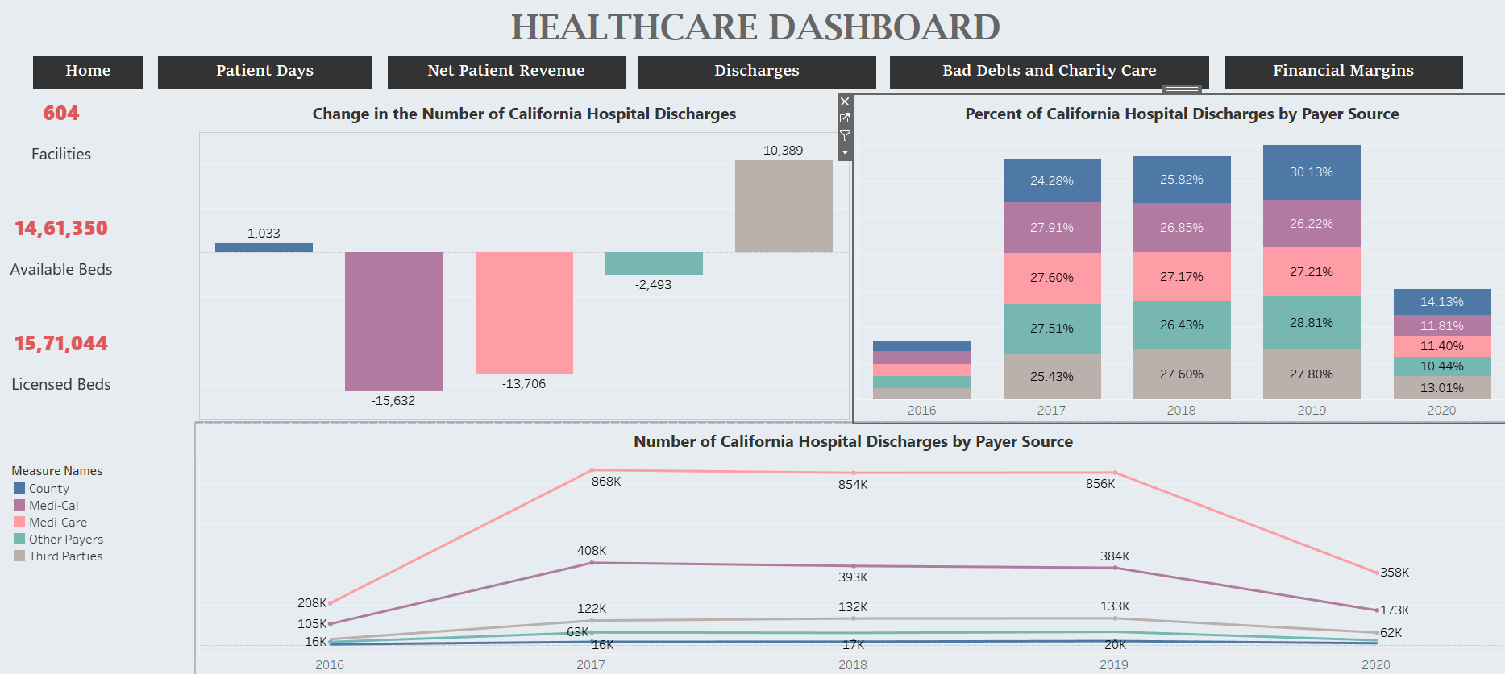
Tableau Dashboard
Patient Days
Bad Debts and Charity
Financial Margins
Net Patient Revenue
Discharges

Slide 8
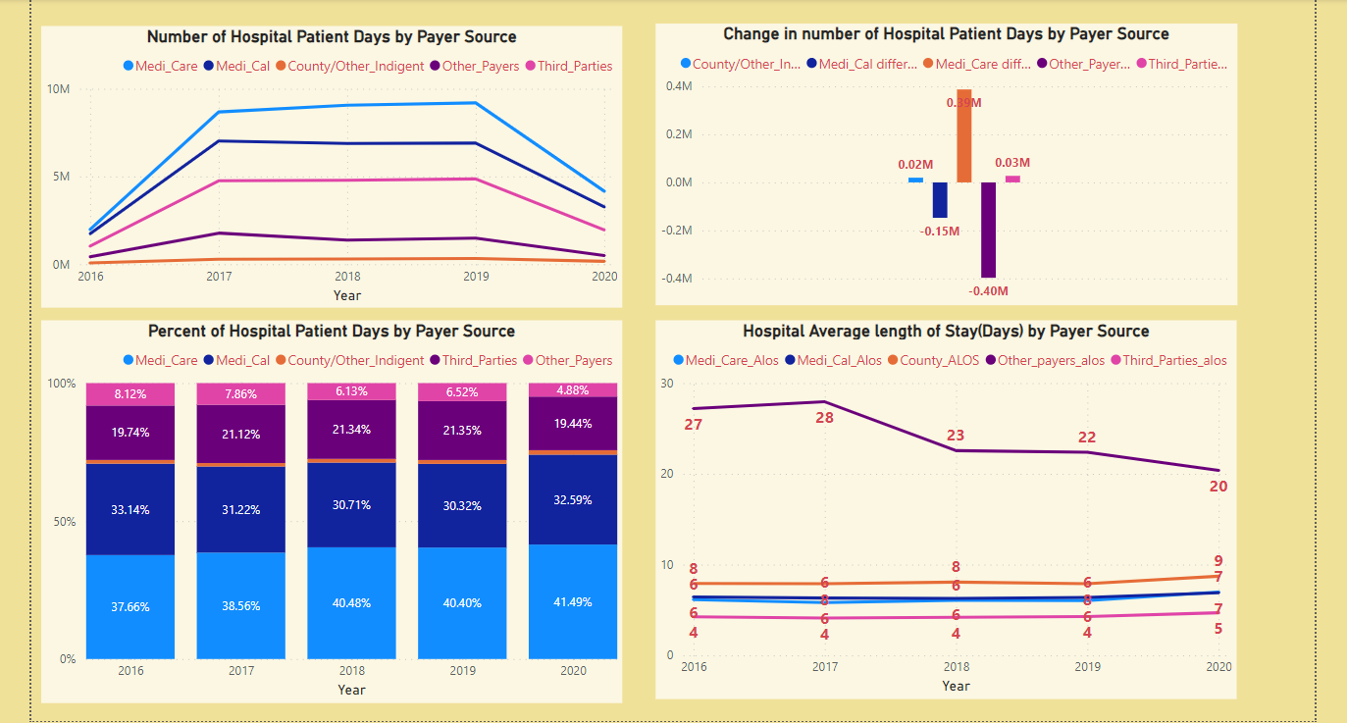
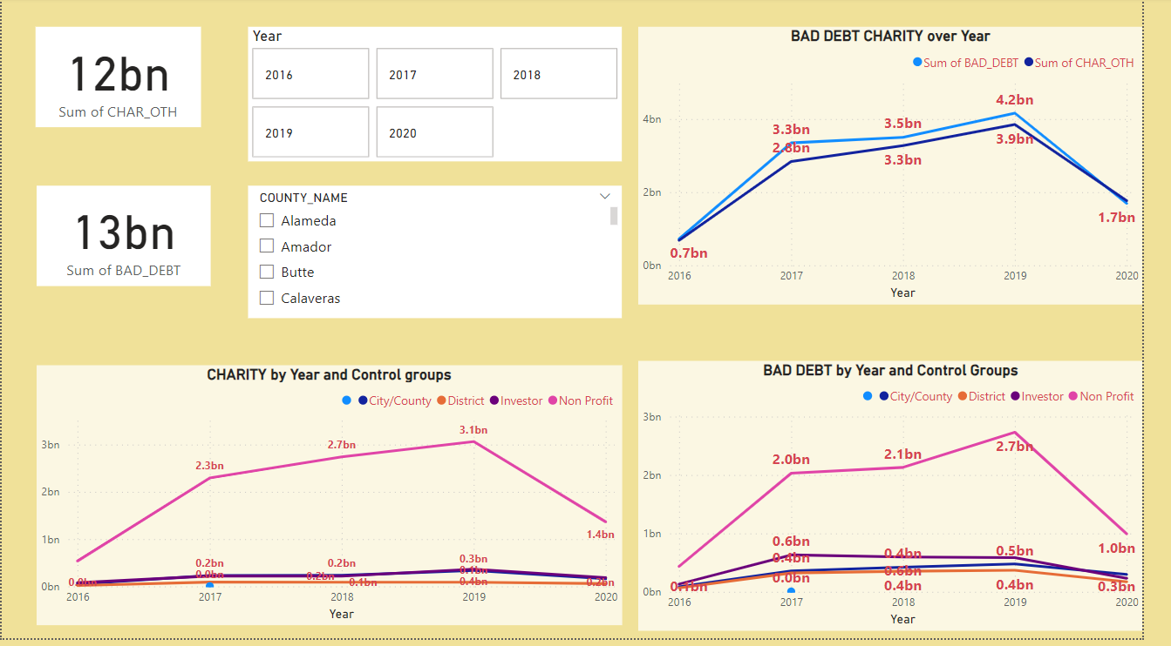
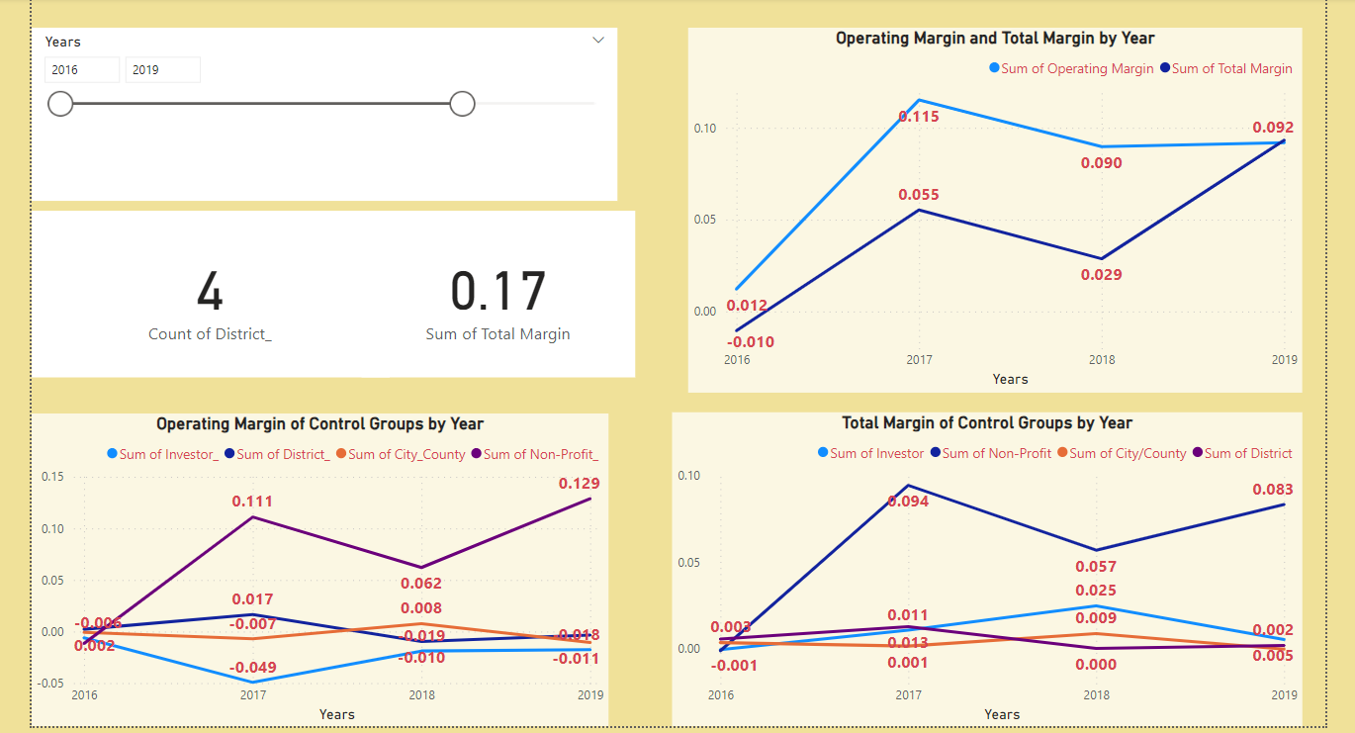
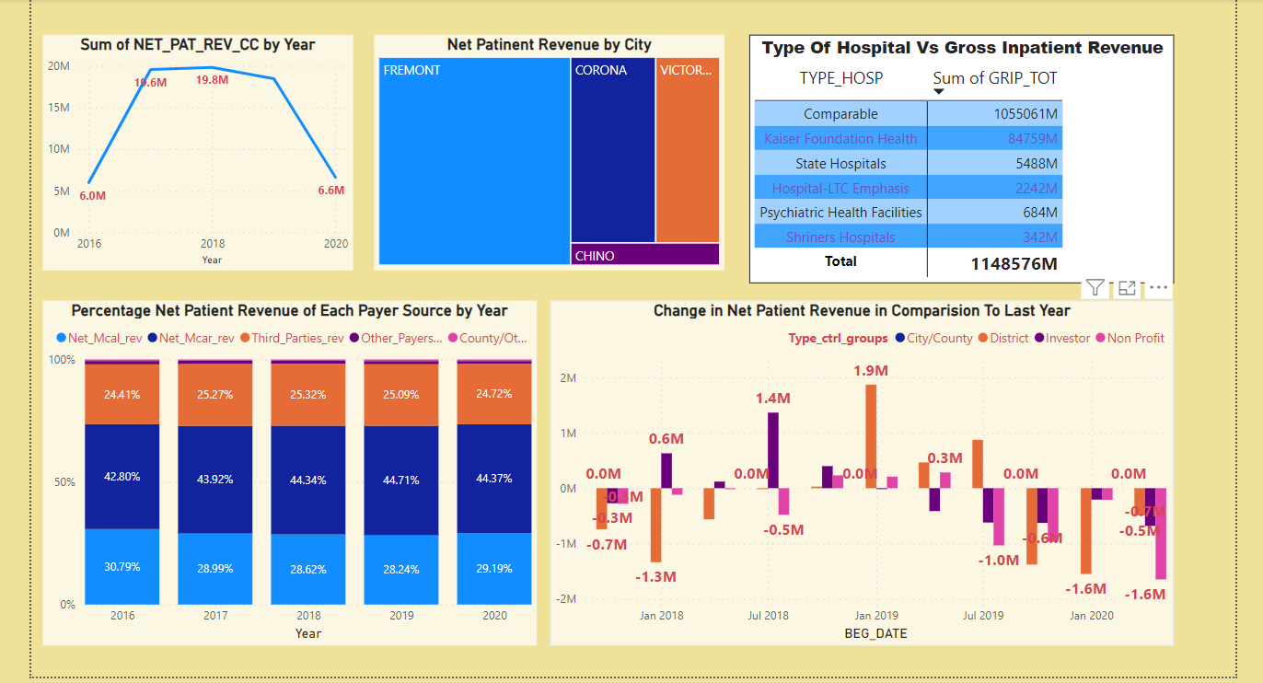
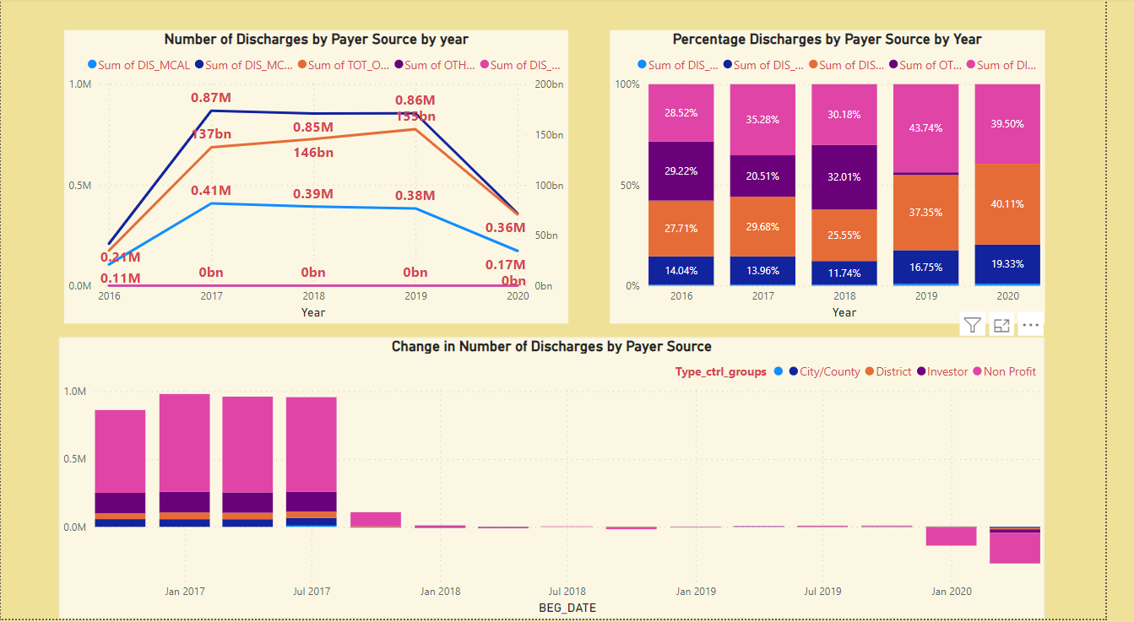
Power BI Dashboard
Patient Days
Bad Debts and Charity
Financial Margins
Net Patient Revenue
Discharges

Slide 9
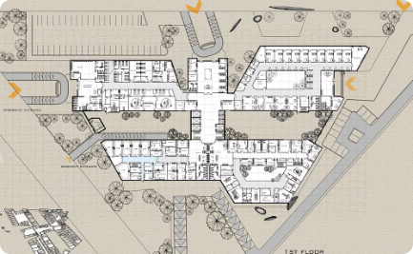

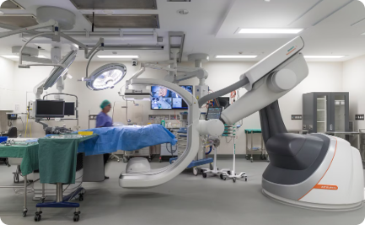
Examination for affordability of healthcare facility construction
and expansion projects
Analysis of Total Margin and operating Margin
Analysis of Bad Debts
and Charity over year
Futuristic Healthcare Center
Operating margins fluctuated annually, with a significant surge in 2020.
City/County and Non-Profit sectors maintained positive trends, while District and Investor sectors showed varied performances over the years.
Steady decline from 2016 to 2020, indicating improved financial management or policy changes.
Non-profit organizations consistently carry the highest bad debt, warranting further investigation into its implications.
Investors have notably higher bad debt and lower operating margin over year, signaling a need for improved debt recovery strategies.
Leading to Utilization of cutting-edge technology for future healthcare demands.

Slide 10



Healthcare disparities and access to care
Healthcare Disparities
1
Varying access and affordability
Barriers to Care
2
Geographical and financial
Equitable Access Solutions
3
Community outreach, policy improvements

Slide 11

Implications for healthcare policy and planning in California
Expansion of telehealth services: Increased accessibility and remote care options.
Equitable distribution of healthcare resources: Addressing disparities in underserved communities.
Policy framework for preventive care: Emphasizing proactive health measures and wellness programs.

Slide 12

Conclusion and Recommendations
Payer Mix Dynamics: Medicare and Medi-Cal reimbursements show a declining trend, while Other Payers exhibit a notable increase, indicating a shift in the healthcare payer mix.
Financial Stability Concerns: Negative reimbursements in Medi-Cal and Other 3rd-Party sectors from 2018 to 2020 raise concerns about financial instability and revenue management. Healthcare providers should conduct a strategic review to ensure sustainability amidst changing reimbursement dynamics.
Sector-Specific Strategies: District and Investor sectors should analyze factors influencing their margin fluctuations and implement targeted financial management strategies.
Continuous Monitoring: Regular monitoring of financial performance is essential to identify trends and make informed decisions to sustain or improve margins across all sectors.

Slide 13


